Slide 1

HOTEL RESERVATION OPERATIONS ANALYTICS
Findings & Business Insights
Presented by:
NAMMI NAGA TANUJA

Slide 2

About Me
• B-Tech in Computer Science and Engineering(Cyber Security) - Raghu Institute of Technology
• Why Data Science: Interested in using data and automation to reduce repetitive work and improve decision-making.
• Project Skills: SQL joins, aggregation, GROUP BY/HAVING, CASE statements, CTEs and analytical queries.
• Current Focus: Advanced SQL, database design and data analysis.
LinkedIn: https://www.linkedin.com/in/nammi-naga-tanuja-7b4016293
GitHub: https://github.com/Tanuja4647

Slide 3
Agenda
Project Objective
1
2
Data Model & Analysis Questions
3
Key Findings & Business Insights
4
Q&A
5
Challenges & Learnings
03
INNOMATICS RESEARCH LABS

Slide 4
Objective of the Project
1
Core Goal: Transform hotel reservation data into actionable operational insights using SQL.
Operational Analysis: Understand hotels, guests, bookings, rooms and stay outcomes.
Problem Analysis: Identify cancellations, no-shows, service-request patterns and operational hotspots.
Revenue Analysis: Measure booking value, lost revenue and revenue-loss trends.
Technical Execution: Apply joins, GROUP BY/HAVING, CASE statements, conditional aggregation and date analysis.
3
5
03
INNOMATICS RESEARCH LABS

Slide 5
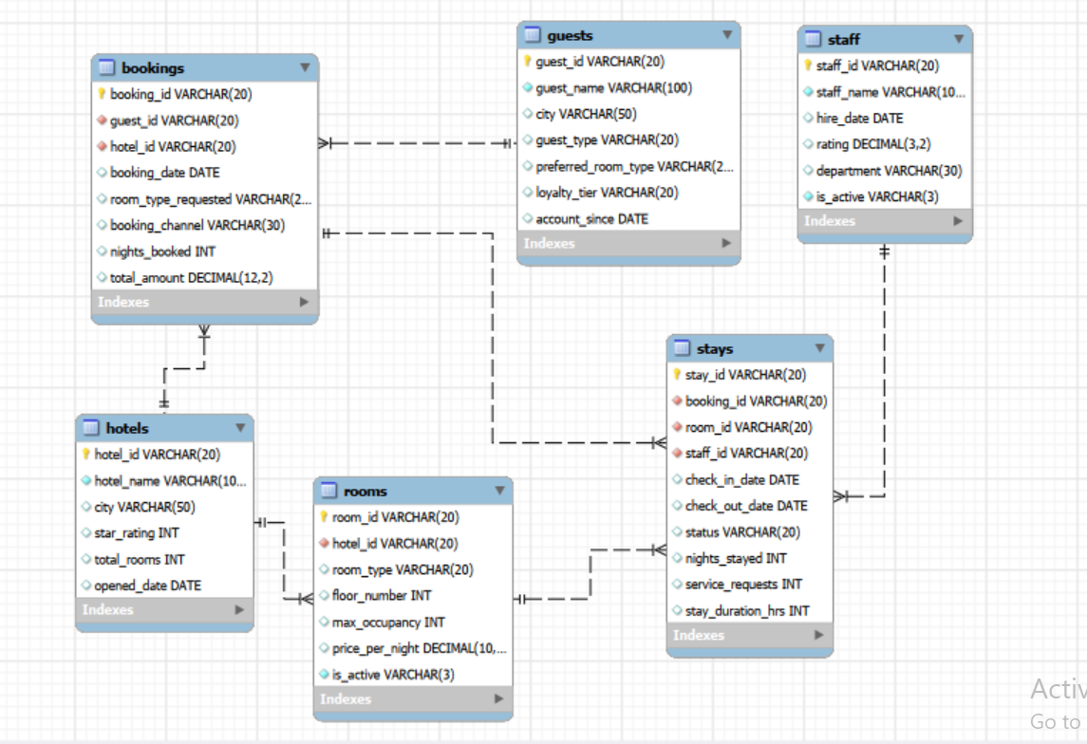
ER Diagram
Hotel Reservation Data Model

Slide 6
Key Analysis Questions
Analysis Questions | SQL Query | Outcome / Insight
What is the total number of guests? | SELECT COUNT(*) AS total_guests FROM guests; | Returns the total size of the guest database — the full customer base collected.
What is the total number of bookings? | SELECT COUNT(*) AS total_bookings FROM bookings; | Shows overall booking volume, a key measure of business activity.
What is the total number of stays? | SELECT COUNT(stay_id) AS total_stays FROM stays; | Indicates how many bookings actually converted into completed stays.
What are the different room types available? | SELECT DISTINCT room_type FROM rooms; | Lists the room type categories offered across the hotel portfolio.
How many staff members are currently active? | SELECT COUNT(*) AS active_staff FROM staff WHERE is_active = TRUE; | Reflects current staffing levels available to support operations.
What are the different booking channels? | SELECT DISTINCT booking_channel FROM bookings; | Identifies all channels guests use to make a reservation.
What is the total booking amount across all bookings? | SELECT SUM(total_amount) AS total_booking_amount FROM bookings; | Gives the total revenue generated from all bookings combined.
What is the average nights booked per booking? | SELECT AVG(nights_booked) AS avg_nights_per_booking FROM bookings; | Shows the typical length of stay guests book on average.

Slide 7
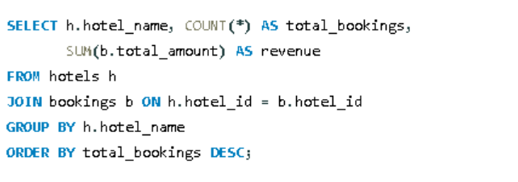
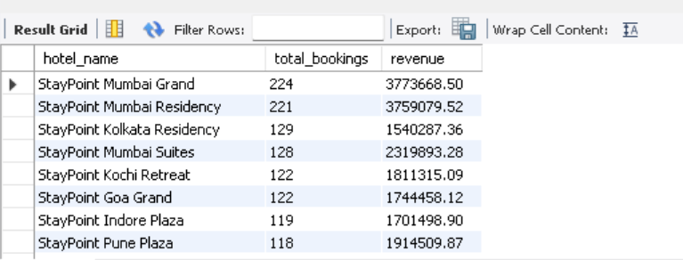
1. Which hotels generate the most bookings?
SQL ANALYSIS
KEY INSIGHT
• StayPoint Mumbai Grand leads with 224 bookings (₹37.7L revenue).
• StayPoint Mumbai Residency follows closely with 221 bookings.
• Mumbai-based properties clearly dominate booking volume.

Slide 8
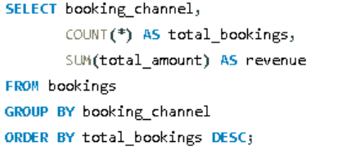
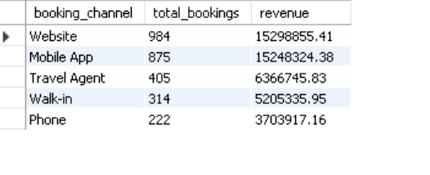
2. Which booking channels bring the most business?
SQL ANALYSIS
KEY INSIGHT
• Website (984 bookings) and Mobile App (875) are the top two channels.
• Together, digital channels generate over ₹3.05Cr in revenue.
• Phone bookings are the smallest channel, at just 222 bookings.

Slide 9
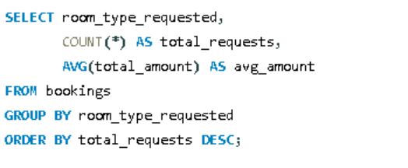
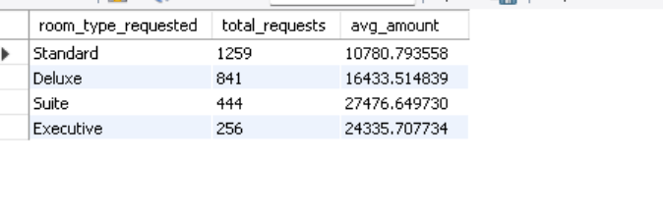
3. Which room types are requested the most?
SQL ANALYSIS
KEY INSIGHT
• Standard rooms are requested most often (1,259 bookings).
• Suites are requested least (444) but carry the highest average value (₹27,477).
• Demand and average booking value move in opposite directions by room type.

Slide 10
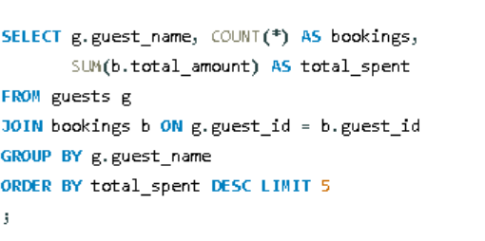
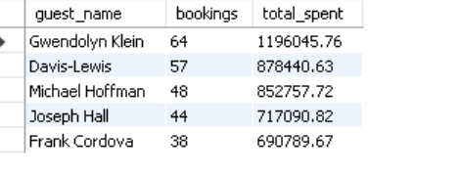
4. Which guests have the highest total spend?
SQL ANALYSIS
KEY INSIGHT
• Gwendolyn Klein is the top spender: 64 bookings worth ₹11.96L.
• The top 2 guests alone account for over ₹20L in combined spend.
• High-frequency guests are a clear target for loyalty programs.

Slide 11
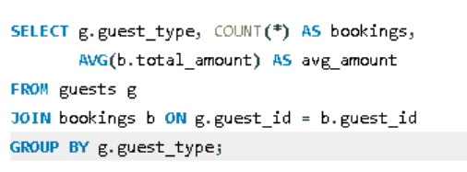
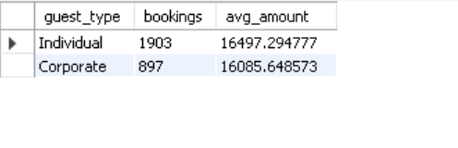
5. How do Individual and Corporate guests compare?
SQL ANALYSIS
KEY INSIGHT
• Individual guests make far more bookings (1,903) than Corporate (897).
• Average booking value is close: ₹16,497 (Individual) vs ₹16,086 (Corporate).
• Individual guests are the primary volume driver for the business.

Slide 12
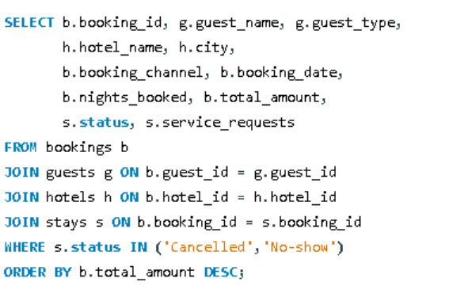
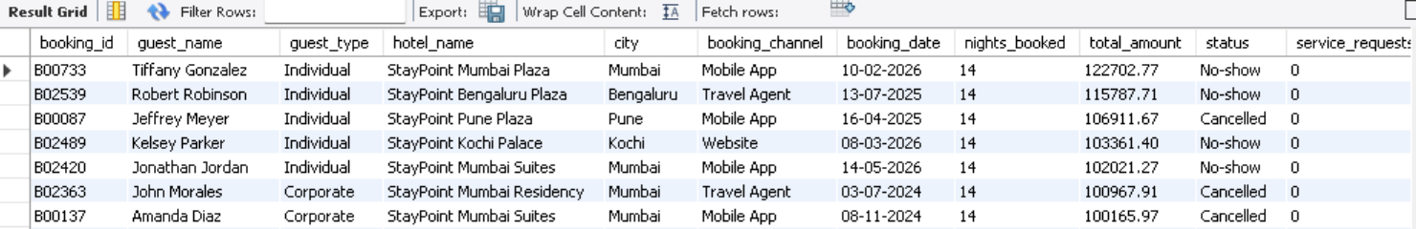
6. Which bookings resulted in cancellations or no-shows?
SQL ANALYSIS
KEY INSIGHT
• 1,022 bookings (31.9% of all stays) ended in a cancellation or no-show.
• The costliest failed booking is worth ₹1,22,703 (No-show, Mumbai Plaza).
• Mobile App and Website bookings dominate the highest-value failures.

Slide 13
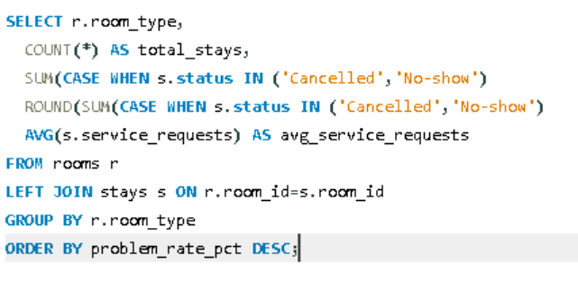
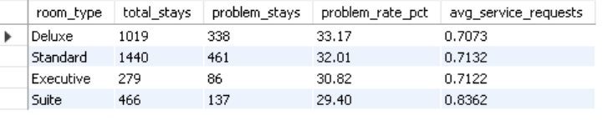
7. Which room types are associated with more problem stays?
SQL ANALYSIS
KEY INSIGHT
• Deluxe rooms have the highest problem rate (33.2%), Standard close behind (32.0%).
• Suites have the lowest problem rate (29.4%) despite the most service requests/stay.
• The spread is narrow (29.4%–33.2%) — room type is a secondary factor.

Slide 14
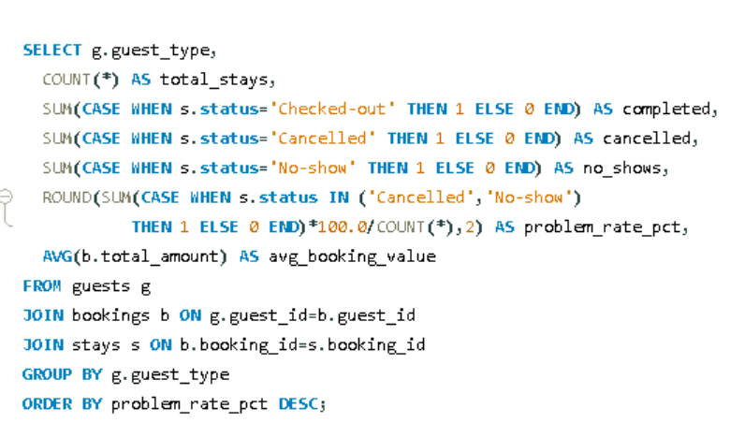
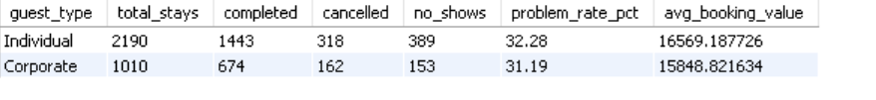
8. Does guest type affect stay completion and problem rates?
SQL ANALYSIS
KEY INSIGHT
• Individual guests show a slightly higher problem rate (32.3%) than Corporate (31.2%).
• Individual guests also carry a higher average booking value (₹16,569 vs ₹15,849).
• The gap is narrow — guest type alone doesn't strongly drive outcomes.

Slide 15
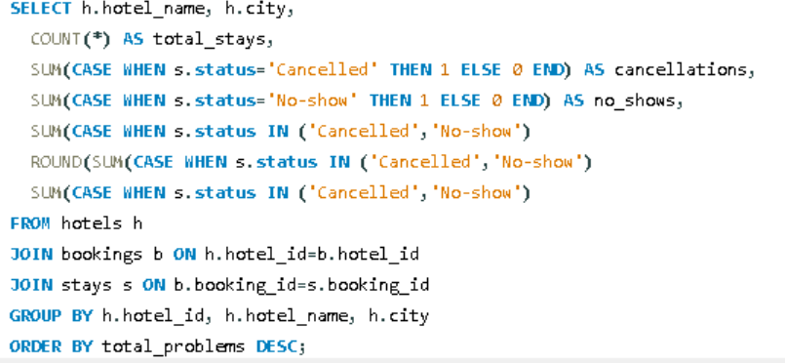
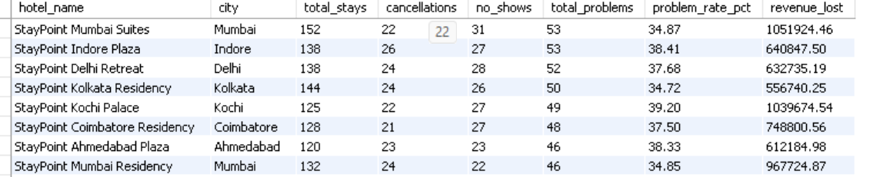
9. Which hotels have the most booking problems?
SQL ANALYSIS
KEY INSIGHT
• StayPoint Mumbai Suites has the most problems overall (53 cases, ₹10.5L lost).
• StayPoint Kochi Palace has the highest problem rate at 39.2%.
• StayPoint Chandigarh Residency is the strongest performer at 19.8%.

Slide 16
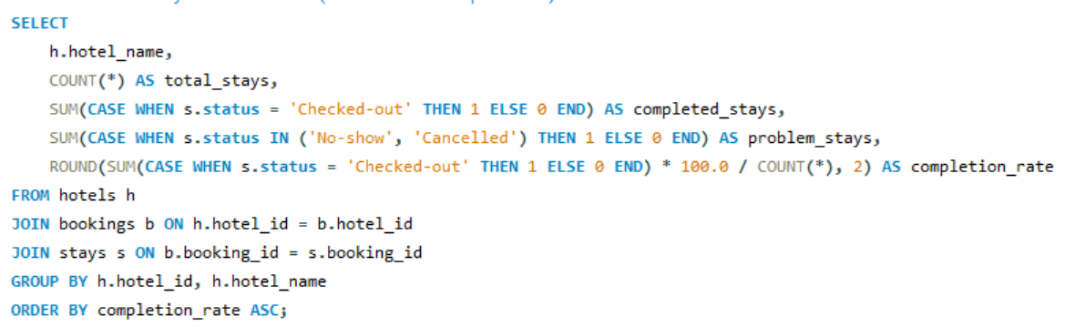
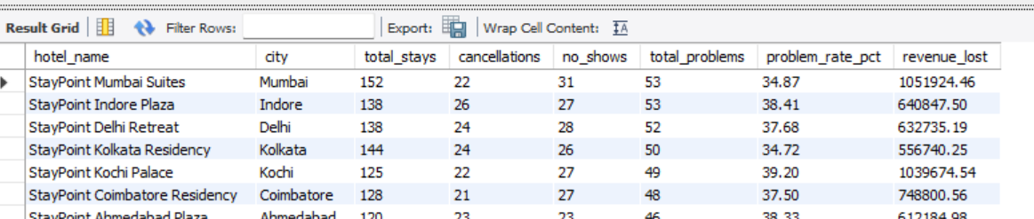
10. Hotel stay success rate (Checked-out vs problems)
SQL ANALYSIS
KEY INSIGHT
• StayPoint Mumbai Suites and Mumbai Residency lead on completion rate (~65%), the two most reliable hotels in the portfolio.
• StayPoint Kochi Palace has the lowest completion rate (~61%) — the weakest performer on checked-out vs. problem stays.
• Even the best hotels lose roughly 1 in 3 stays to cancellations or no-shows — this is a portfolio-wide issue, not a single property's problem.

Slide 17
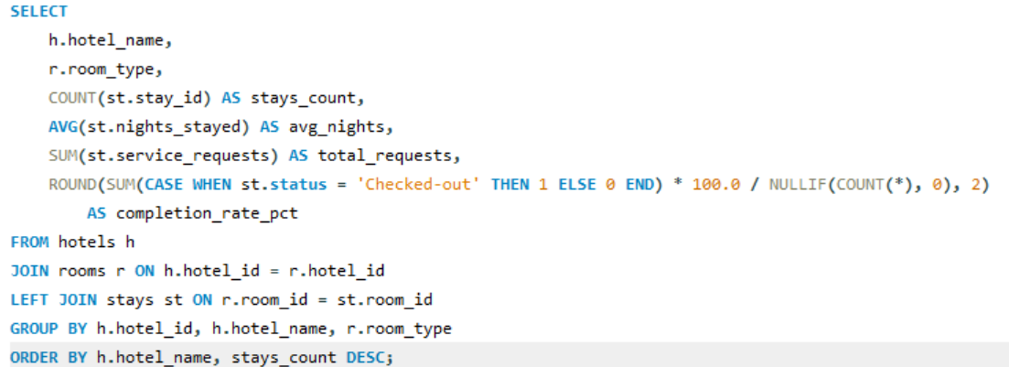
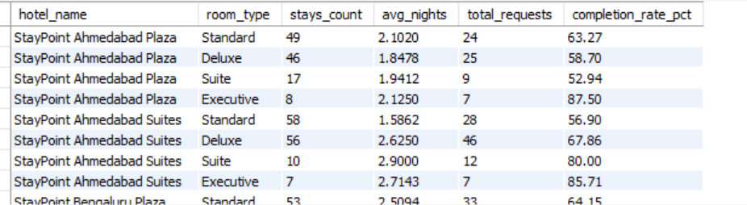
11. Room Performance by Hotel
SQL ANALYSIS
KEY INSIGHT
• Completion rates vary sharply by room type within the same hotel — e.g. at StayPoint Ahmedabad Plaza, Executive rooms complete at 87.5% vs just 52.9% for Suites.
• Standard and Deluxe rooms carry the highest stay volumes (46–58 stays) at both Ahmedabad properties, but not the highest completion rates.
• Room performance is hotel-and-room-type specific — each property needs its own room-level review rather than one blanket fix.

Slide 18
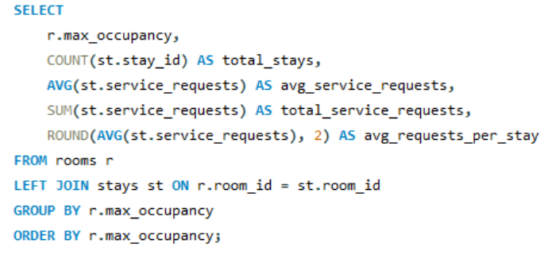
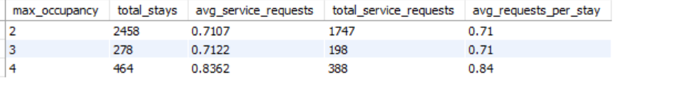
12. Room Capacity vs. Service Requests
SQL ANALYSIS
KEY INSIGHT
• Rooms built for 2 guests dominate stay volume (2,458 stays, ~77% of all stays recorded).
• Larger rooms (max occupancy 4) generate the most service requests per stay (0.84) — about 18% higher than 2- and 3-guest rooms (~0.71).
• 2- and 3-guest rooms behave almost identically in service demand; occupancy-4 rooms are the outlier needing more staff attention.

Slide 19
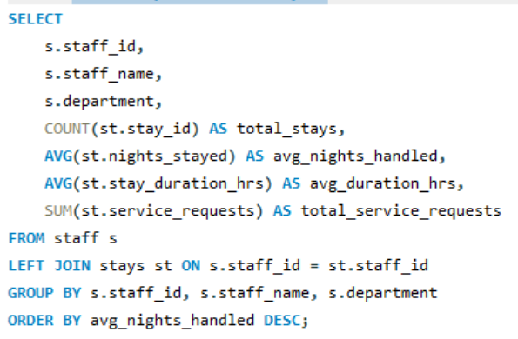
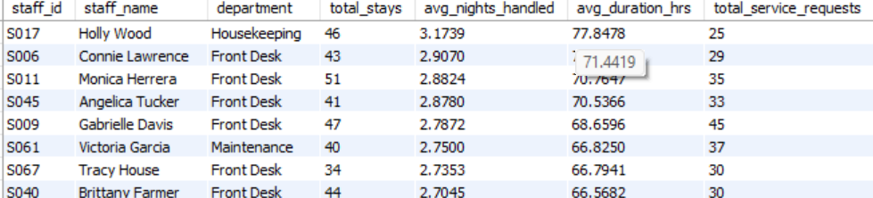
13. Staff Stay Duration Analysis
SQL ANALYSIS
KEY INSIGHT
• Holly Wood (Housekeeping) handles the longest average stays (3.17 nights) — the only non–Front Desk staffer in the top group.
• Front Desk staff dominate the ranking (6 of the top 8), consistently averaging 2.7–2.9 nights handled per stay.
• Service load doesn't track stay length — Gabrielle Davis logs the most requests (45) despite a mid-range 2.79 avg. nights handled.

Slide 20
Experience / Challenges Faced
Challenges Faced
Key Learnings
• Understanding relationships between multiple hospitality tables.
• Validating joins and avoiding duplicate results.
• Using conditional aggregation, CASE statements and date functions.
• Presenting SQL results as simple business insights.
• Designing relational SQL queries across hotels, guests, bookings, rooms, stays and staff.
• Handling multi-table joins while keeping results accurate.
• Translating hotel business questions into measurable SQL outputs.
• Working with stay statuses, dates, service requests and revenue.

Slide 21
Key Findings & Business Insights
1. BOOKING DEMAND
Stay Point Mumbai Grand and Mumbai Residency lead in bookings (224, 221); Website and Mobile App together drive over ₹3.05Cr in revenue.
2. ROOM & GUEST PREFERENCE
Standard rooms are most requested (1,259) and most used (1,440 stays), while Suites are rarest but highest-value (₹8,862/night avg).
4. OPERATIONS
66.2% of stays complete successfully; No-shows (16.9%) edge out Cancellations (15.0%). Staff workload is fairly balanced across departments.
3. GUEST BEHAVIOUR
Individual guests drive far more volume (1,903 vs 897 bookings) than Corporate, though average booking value is nearly identical (~₹16,300).

Slide 22
Recommendations
1. CUT CANCELLATIONS & NO-SHOWS
1,022 bookings (31.9%) end in a cancellation or no-show, with the costliest single loss at ₹1.22L. Introduce prepaid/non-refundable rate options, 24–48h SMS/email reminders, and a calibrated overbooking buffer to recover this revenue.
2. FIX UNDERPERFORMING HOTELS
StayPoint Kochi Palace (39.2%) and Indore Plaza (38.4%) have the highest problem rates, while Chandigarh Residency (19.8%) performs best. Audit staffing and service quality at the weak properties and roll out the top performer's playbook.
3. PUSH HIGH-MARGIN ROOMS
Suites are booked least (444) but earn the most per booking (₹27,477 avg). Bundle suite upgrades and packages to lift occupancy in the highest-margin room category and grow revenue per stay.
4. DOUBLE DOWN ON DIGITAL CHANNELS
Website and Mobile App already drive over ₹3.05Cr in revenue vs just 222 phone bookings. Shift marketing spend further toward digital channels and reduce phone-booking overhead.
5. BUILD A LOYALTY PROGRAM
Top guests such as the highest spender (₹11.96L across 64 bookings) show that high-frequency guests drive outsized revenue. A tiered loyalty program can boost repeat bookings and cut acquisition cost.
6. RIGHT-SIZE SERVICE STAFFING
Occupancy-4 rooms generate 18% more service requests per stay than smaller rooms (0.84 vs 0.71). Align housekeeping and front-desk staffing to occupancy mix, especially at hotels with the lowest completion rates.

Slide 23
Questions, Discussion & Clarifications
Q&A
Thank You

